Slide 1
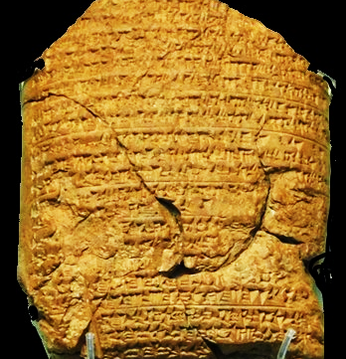
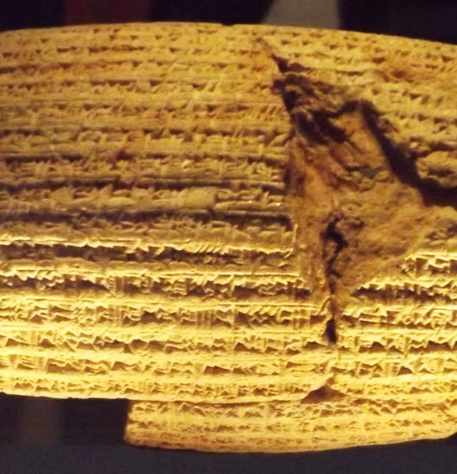
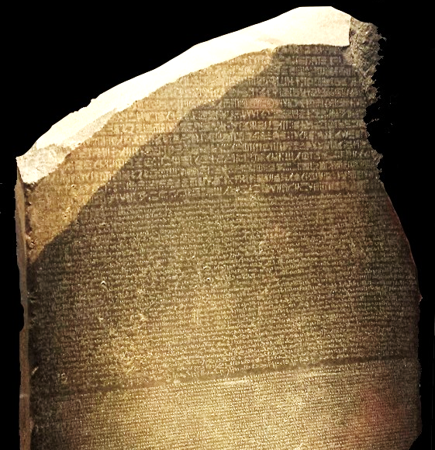
Captivity  Return  Years of Silence
Notes:
Three artifacts symbolizing the captivity, return, and years of silence.
This clay tablet from the Babylonian Chronicle (left) details major events in the Babylonian empire. Each year is separated by a line. This tablet records the exploits of Nebuchadnezzar from 605 to 594 BC, and specifically mentions taking captives and tribute from Jerusalem.
The Cyrus Cylindar (center, circa 530 B.C.) records the policy of Cyrus of Persia to allow captive nations to return to their homelands and rebuild the cities and temples. The Bible prophecies that Cyrus would do this 100 years before he was born (Isaiah 44:28).
The Rosetta Stone (right) is a granodiorite stele, found in 1799, inscribed with three versions of a decree issued at Memphis, Egypt, in 196 BC during the Ptolemaic dynasty on behalf of King Ptolemy V. The top and middle texts are in Ancient Egyptian using hieroglyphic script and demotic scripts, respectively, while the bottom is in Ancient Greek. As the decree has only minor differences between the three versions, the Rosetta Stone proved to be the key to deciphering Egyptian hieroglyphs, thereby opening a window into ancient Egyptian history.

Slide 2
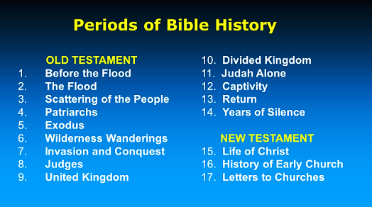

Slide 3
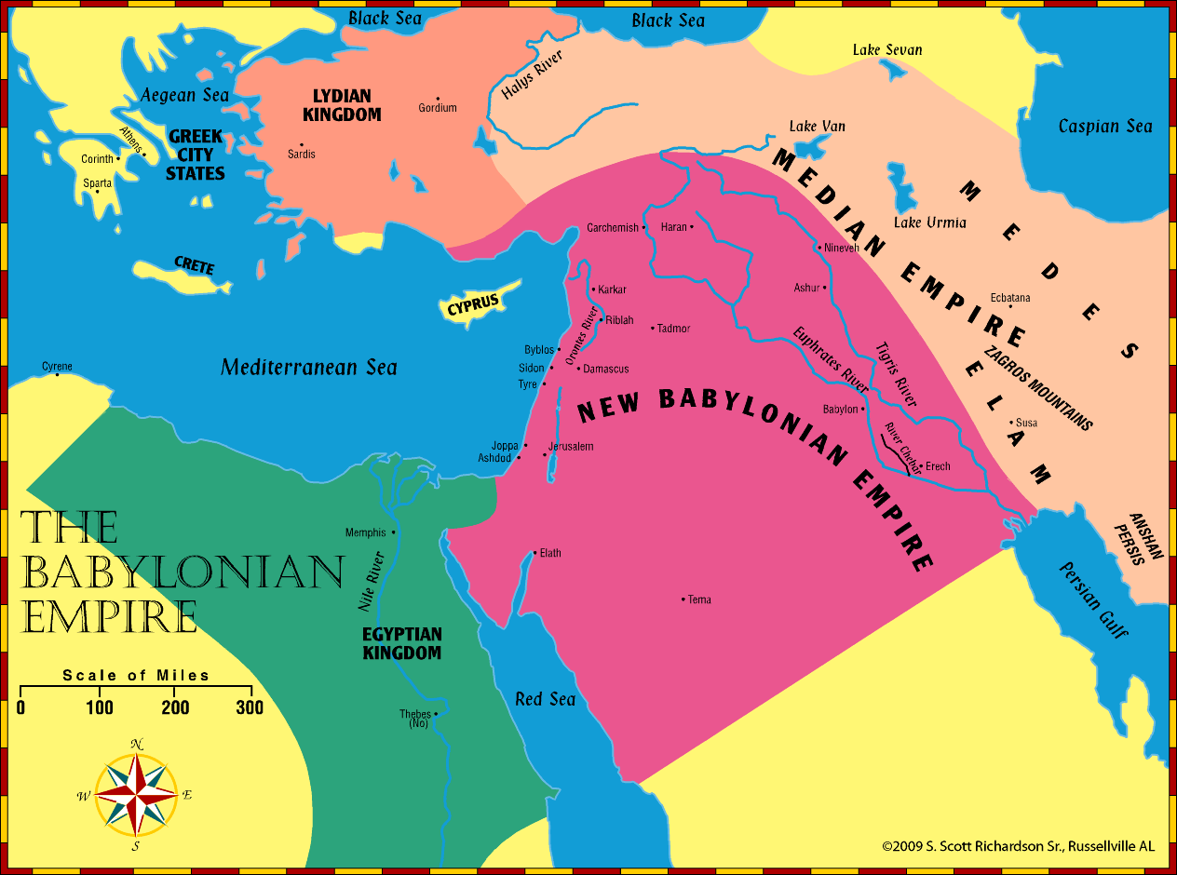
Jeremiah – Daniel – Ezekiel: Timeline (B.C.)
640
627
605
597
593
586
571
536
Daniel
Judah falls & Jerusalem is destroyed
Jeremiah
Ezekiel

Slide 4
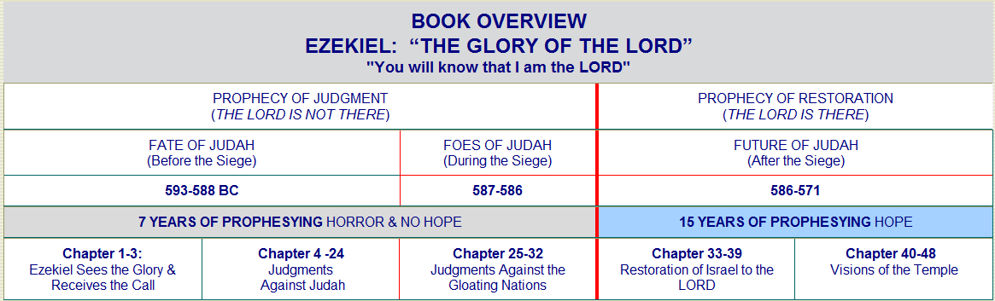
The Fall of Jerusalem

Slide 5
Zedekiah Further Questions Jeremiah & The Fall of Jerusalem Jeremiah 38:14-28; 39:1-14; 40:1-44:30; 52:6-27 Ezekiel 32:1-32; 33:1-22; 36:1-38 2 Kings 25:4-24; 2 Chronicles 36:17-21

Slide 6
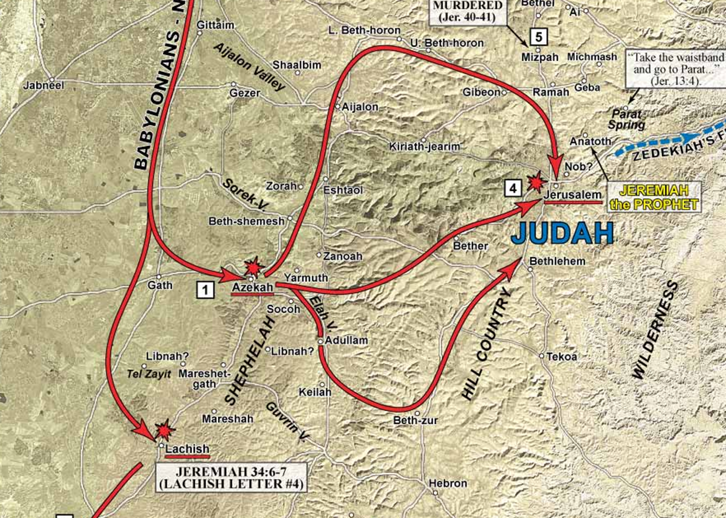
The Babylonian Assault on Judah

Slide 7
Zedekiah Further Questions Jeremiah
Jeremiah 38:1-13 – In Jerusalem with Zedekiah.
Zedekiah allows Jeremiah to be cast into a cistern by four disgruntled officials who didn’t like his prophecy concerning Jerusalem’s pending destruction (38:1-6).
Jeremiah sinks into the mire (38:6b).
A eunuch slave (Ebed-melech) approaches Zedekiah and requested Jeremiah’s rescue (38:7-9).
Zedekiah commands Ebed-melech to free Jeremiah (38:10-13).
Ebed-Melech would later be spared in the Babylonian slaughter because of the kindness he had shown Jeremiah (39:15-18).

Slide 8
Zedekiah Further Questions Jeremiah
Jeremiah 38:14-28 – In Jerusalem with Zedekiah.
Out of the cistern, Zedekiah again questions Jeremiah about a message from God and asks that nothing be withheld (38:14).
Jeremiah’s answer is two-fold (38:15):
“If I tell you, will you not put me to death?”
“If I tell you, you won’t believe me anyway”
Zedekiah promises Jeremiah would not be harmed (38:16).
Again, Jeremiah counsels surrender to Babylon (38:17-18).
The city would be spared and Zedekiah would live.
Otherwise, the city would be burned and the king would not escape from Nebuchadnezzar’s hand.

Slide 9
Zedekiah Further Questions Jeremiah
Jeremiah 38:14-28 – In Jerusalem with Zedekiah.
If he surrenders, Zedekiah fears mistreatment from Jews who had already defected to the Babylonians (38:19).
Jeremiah promises Zedekiah’s obedience would result in his personal safety (38:20).
Jeremiah begs Zedekiah to obey God!
If Zedekiah disobeys, it would ensure his mistreatment by Nebuchadnezzar, the captivity of wives and children, and the burning of the city (38:21-23).
Zedekiah tells Jeremiah to keep their conversation secret (38:24).
Jeremiah is still in the prison court when Jerusalem is taken (38:28).

Slide 10
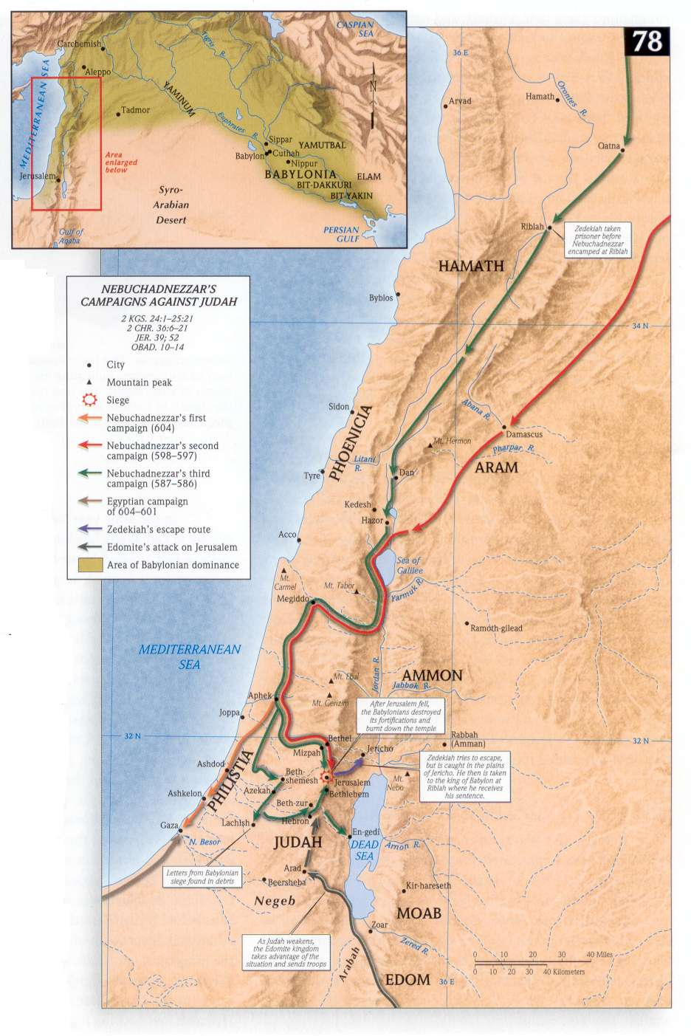
Jerusalem Falls to Babylon (Jeremiah 39; 2 Kings 25; 2 Chr. 36)
After a siege of 18 months, the city of Jerusalem falls in 586 BC, and Babylonian princes sit in its middle gate (39:1-3).
Zedekiah tries to escape but is captured on the plains of Jericho (39:4-7).
He is taken to Riblah of Hamath where his sons are killed and his eyes are put out.
The rest of his life is spent in Babylon.
The Babylonian captain Nebuzaradan destroys Jerusalem, takes the remnant captive, and leaves only the poor in the land (39:8-10).
Zedekiah had paid no heed to Jeremiah!
Zedekiah is taken to Hamath
Notes:
What Jeremiah had said made no difference to Zedekiah
Remember Ezekiel’s prophecy in Ezekiel 12
Sometimes preachers preach and teachers teach and seems to make no difference.
Ezekiel 33:31-32 And they come to you as people come, and they sit before you as my people, and they hear what you say but they will not do it; for with lustful talk in their mouths they act; their heart is set on their gain. 32 And behold, you are to them like one who sings lustful songs with a beautiful voice and plays well on an instrument, for they hear what you say, but they will not do it.

Slide 11
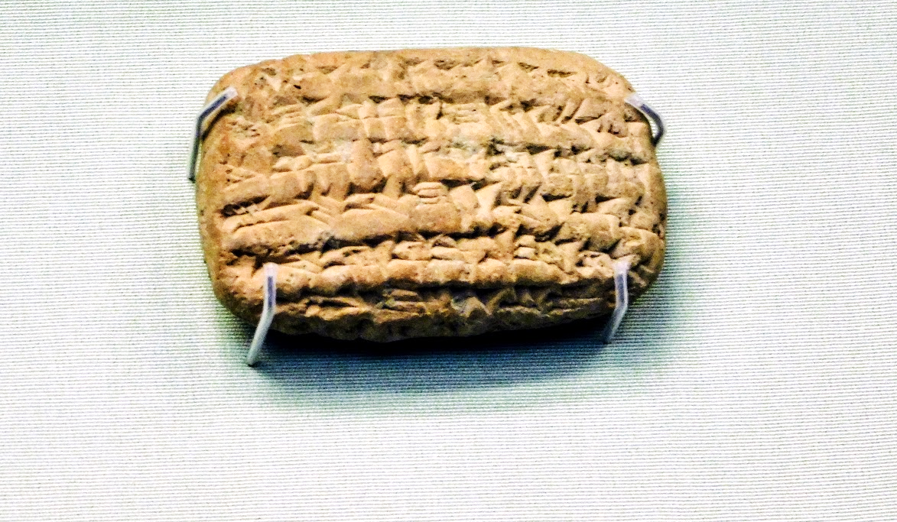
Nebu-sar-sekim Tablet Inscription The tablet mentions “Nebu-sarsekim the chief Eunuch” of Nebuchadnezzar. Scholars date the tablet to 595 B.C.
Jeremiah 39:2-3
“In the eleventh year of Zedekiah, in the fourth month, on the ninth day of the month, a breach was made in the city. Then all the officials of the king of Babylon came and sat in the middle gate: Nergal-sar-ezer of Samgar, Nebu-sar-sekim the Rab-saris, Nergal-sar-ezer the Rab-mag, with all the rest of the officers of the king of Babylon.”
Photo by Steve Klein

Slide 12
Jerusalem Falls to Babylon (Jeremiah 39; 2 Kings 25; 2 Chr. 36)
The Lord protects Jeremiah (39:11-14).
Nebuchadnezzar orders Nebuzaradan to see that no harm comes to Jeremiah.
Jeremiah is released from prison and put in the keeping of Gedaliah.
God promises to deliver Ebed-Melech (39:15-18).
The Ethiopian Ebed-Melech had shown far more trust in the Lord than the king and princes of Judah!

Slide 13
Jerusalem Falls to Babylon (Jeremiah 39; 2 Kings 25; 2 Chr. 36)
The city is destroyed one month later.
The palace and homes are burned; the city wall is demolished all around.
The people are taken captive; only the poor are left behind.
All the city’s wealth is looted, including the two giant bronze pillars Solomon made (cf. 1 Kings 7).
Some political leaders and officials were executed.
Jerusalem’s devastation visibly remained until “the land had enjoyed its sabbaths” (2 Chron 36:21).
Jeremiah weeps (Lamentations 1:1-3).
Nebuchadnezzar appoints Gedaliah as governor over the land; he encourages submission to Babylon in order to live in peace.
Notes:
2 Chronicles 36:20-21 And those who escaped from the sword he carried away to Babylon, where they became servants to him and his sons until the rule of the kingdom of Persia, 21 to fulfill the word of the LORD by the mouth of Jeremiah, until the land had enjoyed her Sabbaths. As long as she lay desolate she kept Sabbath, to fulfill seventy years.
Lamentations 1:1-3 How lonely sits the city That was full of people! How like a widow is she, Who was great among the nations! The princess among the provinces Has become a slave! 2 She weeps bitterly in the night, Her tears are on her cheeks; Among all her lovers She has none to comfort her. All her friends have dealt treacherously with her; They have become her enemies. 3 Judah has gone into captivity, Under affliction and hard servitude; She dwells among the nations, She finds no rest; All her persecutors overtake her in dire straits.

Slide 14
Aftermath of Jerusalem’s Fall (Jeremiah 40-44)
Gedaliah is murdered by Ishmael (a field captain) who had been hired by the Ammonites to do so (Jer. 40-41).
Gedaliah was warned about Ishmael but didn’t believe it.
Fearing what Nebuchadnezzar might do in response to Gedaliah’s murder, the Jews ask Jeremiah for a message from God – should they flee to Egypt (42:1-2)?
They promise to do whatever he says (42:3-6).
Jeremiah tells them to stay in the land and enjoy God’s peace and mercy or flee to Egypt and die by the sword (42:7-22).
They refuse to obey and head to Egypt with Jeremiah in tow; Jeremiah pronounces their doom (43-44).

Slide 15
Aftermath of Jerusalem’s Fall (Ezekiel 32-33, 36)
Ezekiel -- in Babylon with the captives.
Ezekiel was to be a watchman (33:1-20).
He is charged with warning the people on God’s behalf (33:7-9).
God’s leaders today have a similar responsibility (Acts 20:26-27).
He is informed of Jerusalem’s destruction one year after it was burned (33:21).
Now his days of being muted will end (33:22; cf. 3:26-27; 24:26-27).
The Jews had assumed that their numbers and status as heirs of Abraham would assure future peace and prosperity (33:23-24).
Instead, their wicked hypocrisy and stubbornness assured their demise (33:25-29).
God promises restoration of the land and His people (36:1-38).*
Notes:
Ezekiel 3:26-27 I will make your tongue cling to the roof of your mouth, so that you shall be mute and not be one to rebuke them, for they are a rebellious house. 27 But when I speak with you, I will open your mouth, and you shall say to them, 'Thus says the Lord GOD.' He who hears, let him hear; and he who refuses, let him refuse; for they are a rebellious house.
Ezekiel 24:24-27 Thus Ezekiel is a sign to you; according to all that he has done you shall do; and when this comes, you shall know that I am the Lord GOD.' " 25 'And you, son of man—will it not be in the day when I take from them their stronghold, their joy and their glory, the desire of their eyes, and that on which they set their minds, their sons and their daughters: 26 on that day one who escapes will come to you to let you hear it with your ears; 27 on that day your mouth will be opened to him who has escaped; you shall speak and no longer be mute. Thus you will be a sign to them, and they shall know that I am the LORD.’ “
*Esp. 36:7-12

Slide 16
Application
God will judge His people.
The disobedient will incur His wrath.
“I, the LORD, have spoken it; It shall come to pass, and I will do it; I will not hold back, nor will I spare, nor will I relent; According to your ways and according to your deeds They will judge you," says the Lord GOD’“ (Ezekiel 24:14).
“For the Son of Man will come in the glory of His Father with His angels, and then He will reward each according to his works” (Matthew 16:27).

